Slide 1
Library management system
\

Slide 2
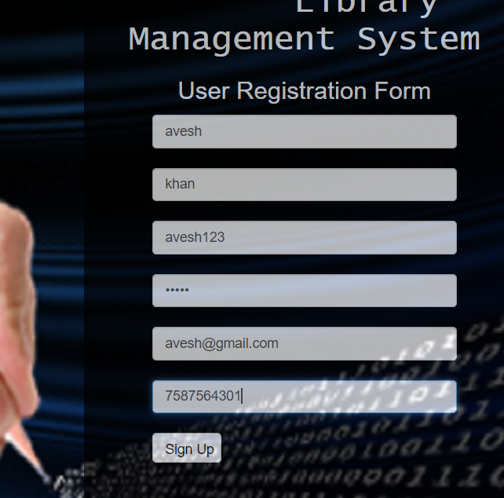

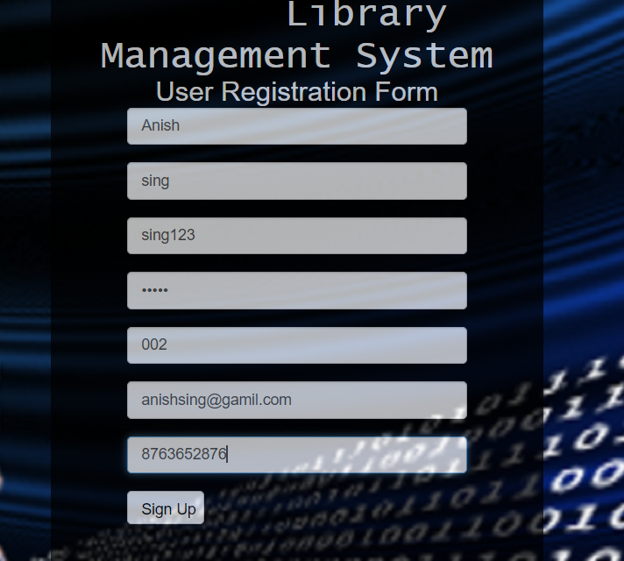
Signup testing
valid input:
for admin:
admin can enter –first name ,last name, username, password, email, phone no.
After signup admin information add in admin database
For student:
student can enter –first name ,last name username ,password, roll number, email ,phone no.
After signup student information added in database

Slide 3
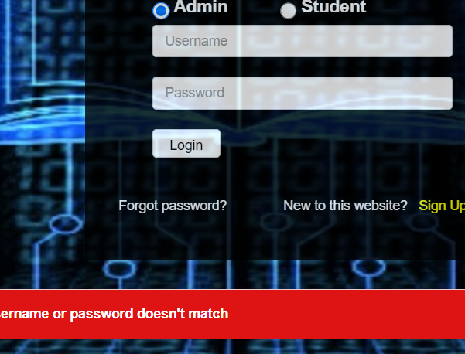
Login testing: admin login: invalid for Input –username and password after Enter invalid input admin profile show

Slide 4
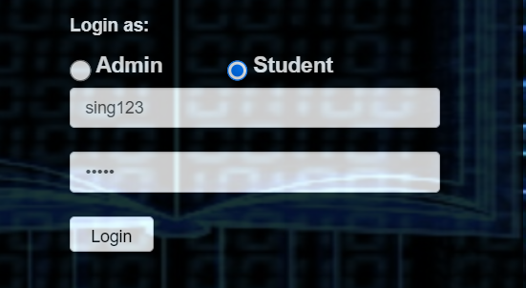
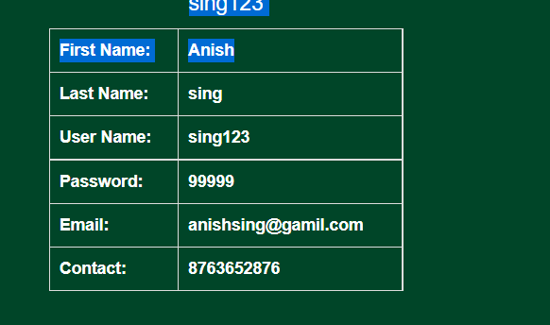
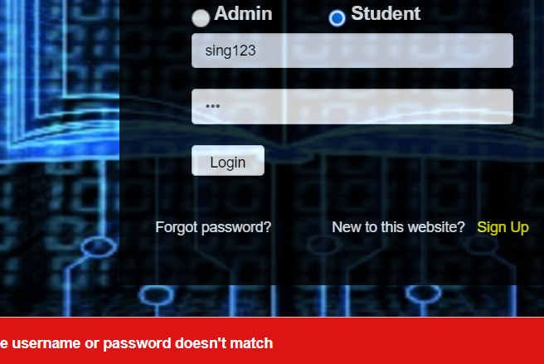
Login as student: valid input enter username and password after enter valid input student profile show if invalid username or password enter then show message

Slide 5
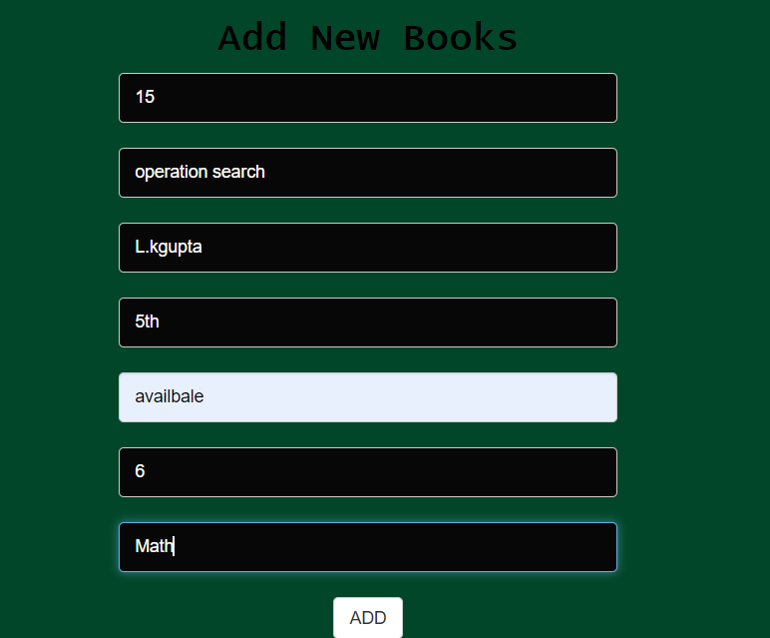
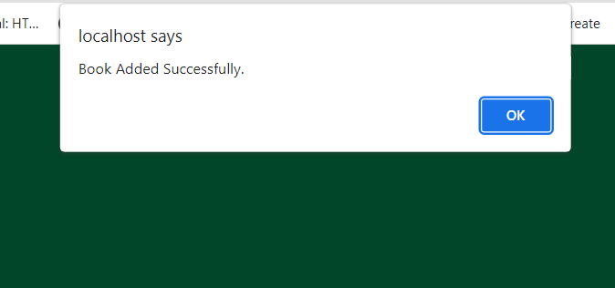
Admin add new book testing
Admin enter all information
message show –Book added successfully
This book add in list of books
Books information also added in database

Slide 6
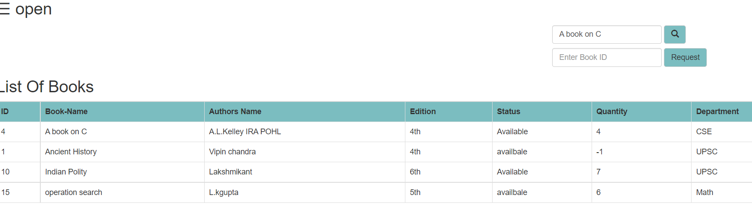
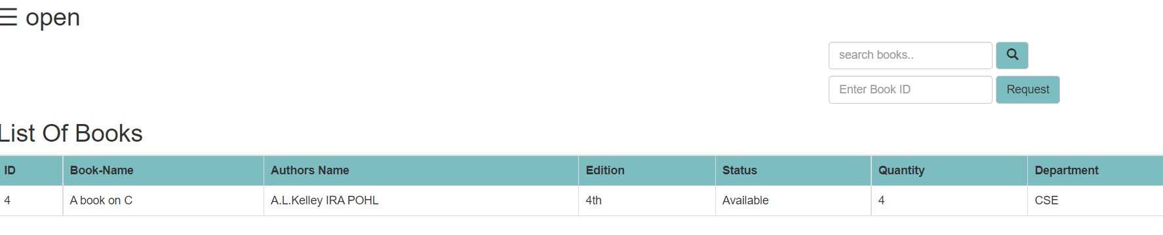
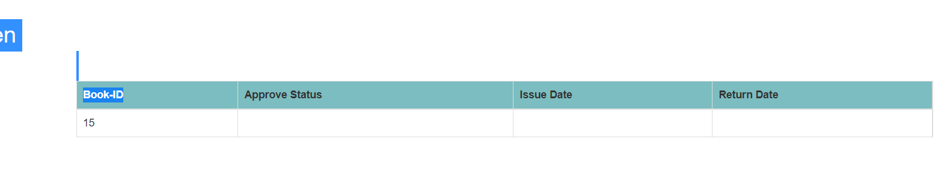
Student search and request testing
Student can search books by book name
Student can request book by book id

Slide 7
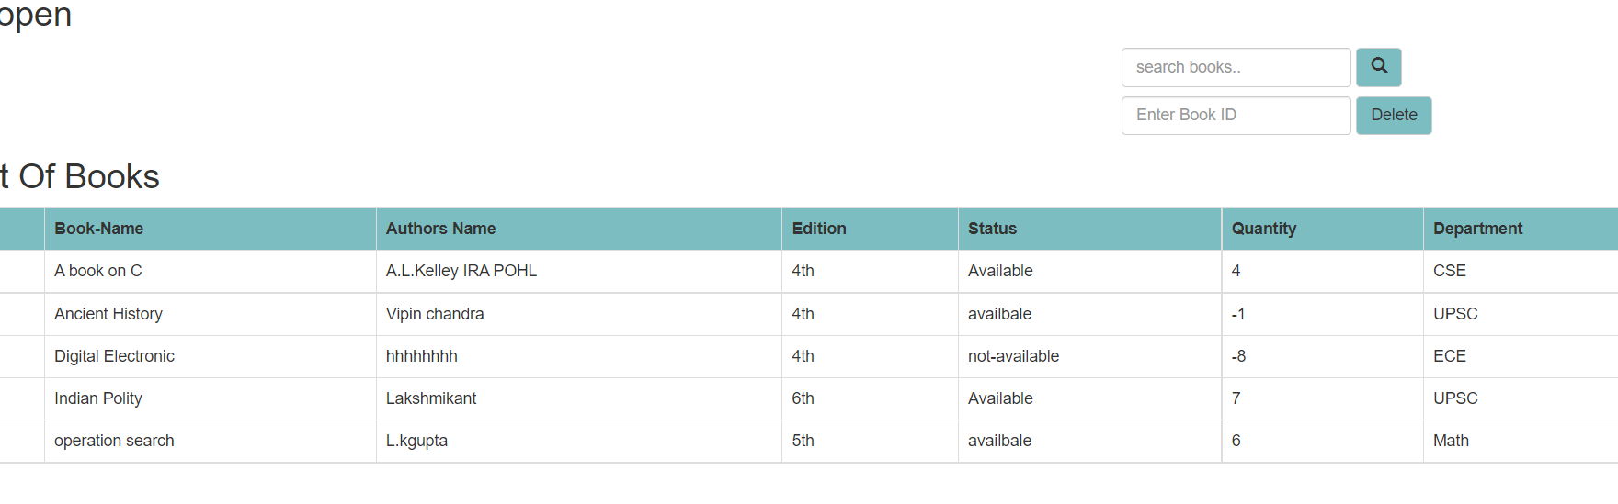
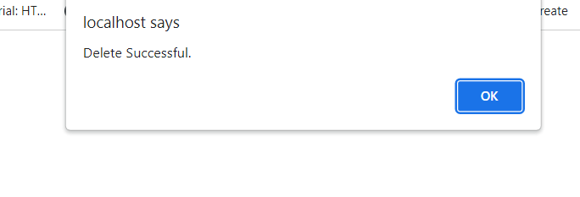
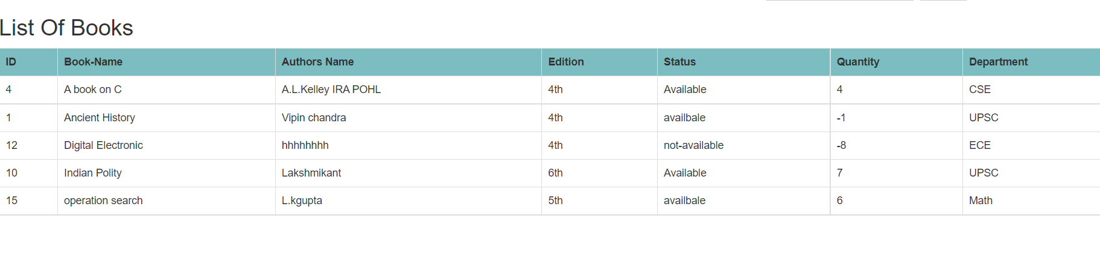
admin delete a book testing
Admin delete book from book list
After delete book message show
And remaining book list are there

Slide 8
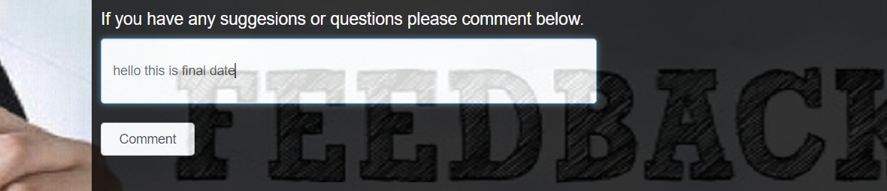
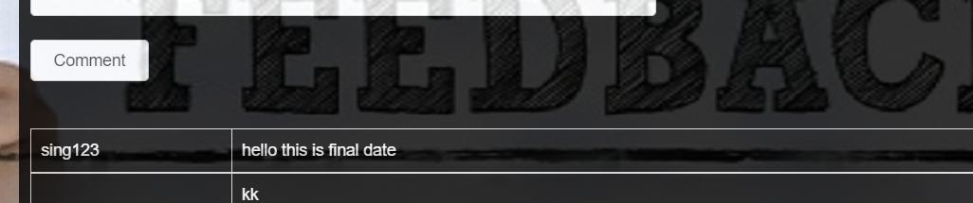
Feedback testing
Student feedback

Slide 9
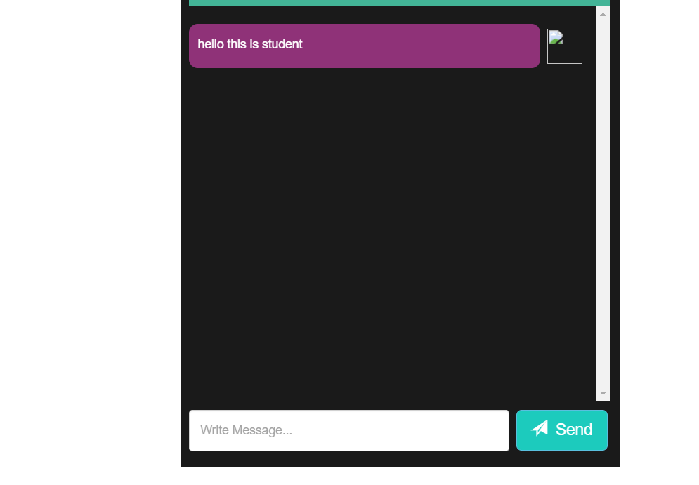
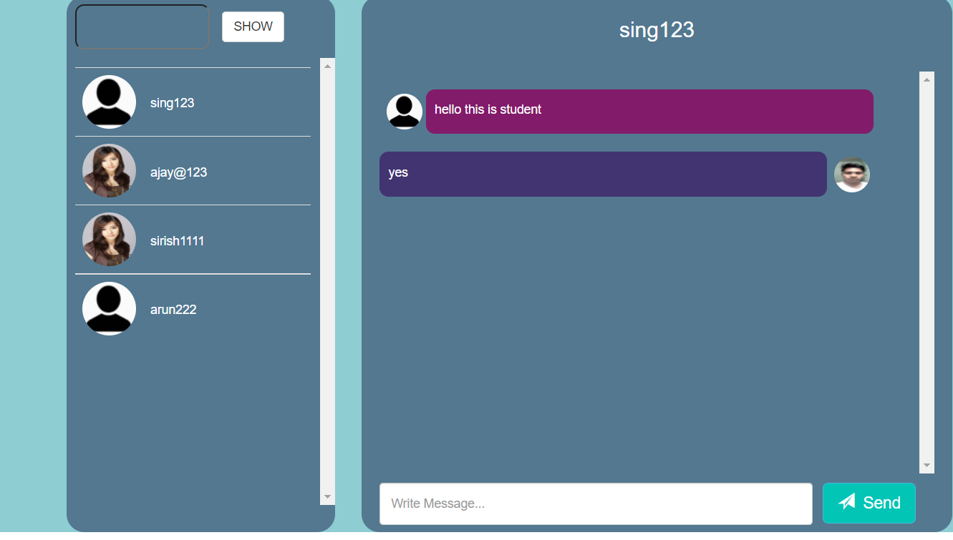
Message testing
Student and admin can communicate each other

Slide 10
Thank you

